Slide 1
R Data Visualisation
Presenter：Alfred Hou

Slide 2
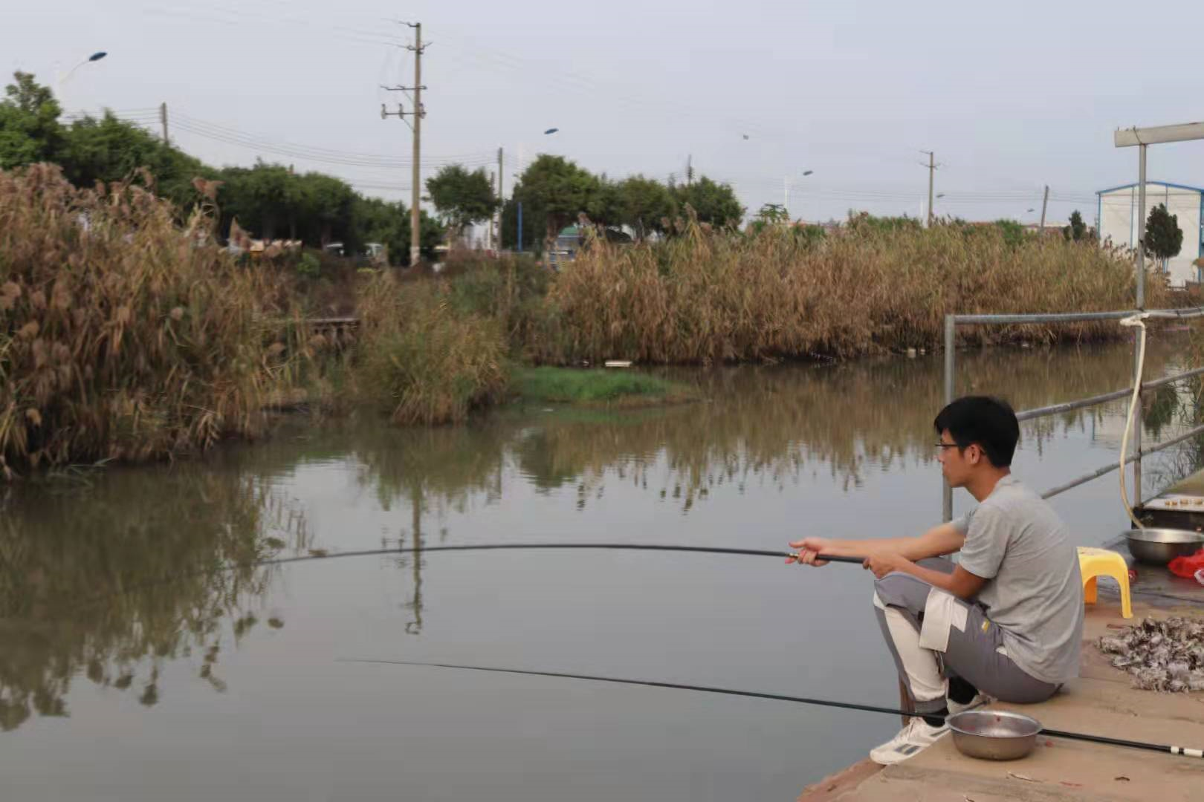
Self Introduction
Name：Alfred Hou(侯壮伟)
Research：Population Genomics
Network Team：Biological Pits Bioinformatics Team(生物坑生信团队)
Academic organisations：Chinese Genomics Meet-up online（华人基因组沙龙）
Wechat Official Accounts：高通量测序技术 CGM基因组沙龙
QQ Group：933196696
Educational experience:
2014.09-2018.06 Hunan Agricultural University Tobacco Science
2018.09-2021.06 Sun Yat-sen University Botany

Slide 3
What is the purpose of visualisation ?

Slide 4
What shall we do before visualisation ?

Slide 5
Why R ?

Slide 6
Why ggplot2 ?

Slide 7
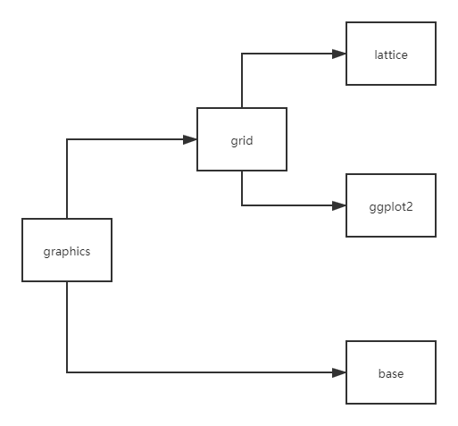
R Graphics
base
low-level graphics system
paper and pencil without eraser
authored by R Core Team
grid
low-level graphics system
produces graphical objectes which can be edited
allow arbitrary modifications of plots produced by lattice and ggplot2
authored by Paul Murrell

Slide 8
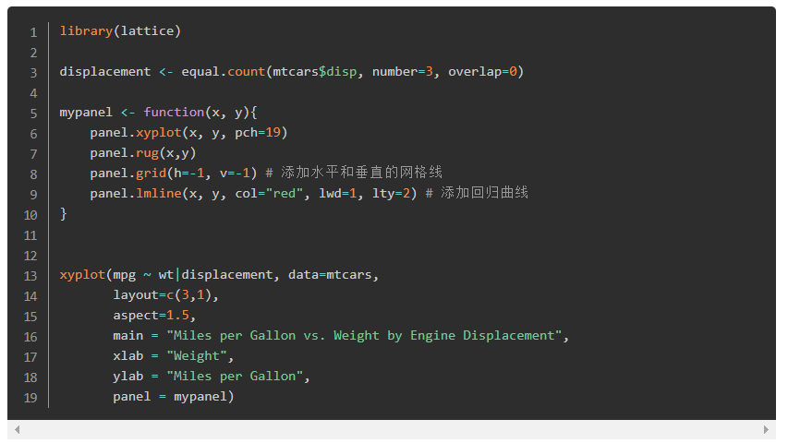
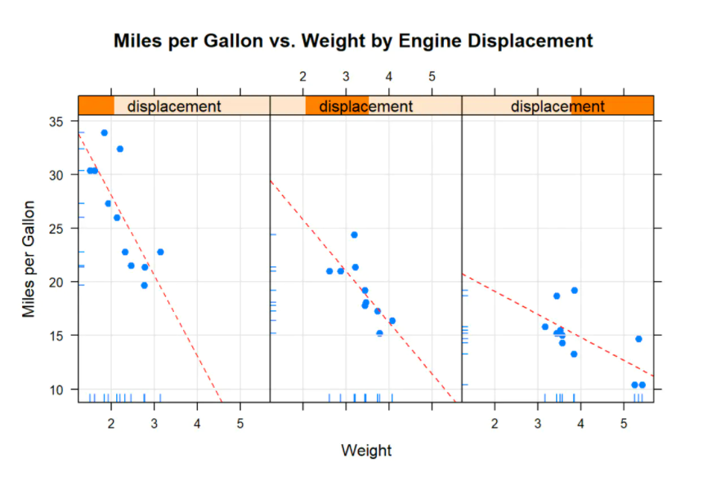
high-level data visualisation system
lattice
an implementation of Trellis graphics(S & S-PLUS)
emphasis on multivariate data
authored by Deepayan Sarkar

Slide 9
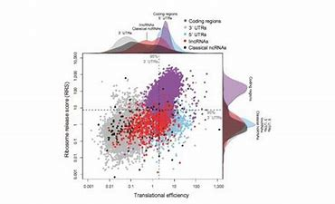
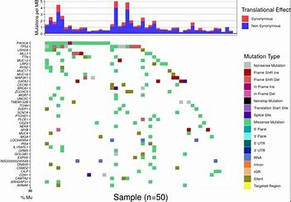
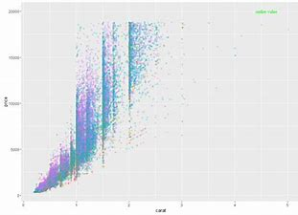
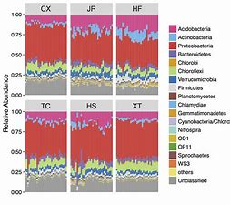
high-level data visualisation system
ggplot2
follows a grammer, just like any language(Wilkinson, 2005)
plot specification at a high level of abstraction
theme system for polishing plot appearance
activate user community with lots of extensions
authored by Hadley Wickham

Slide 10
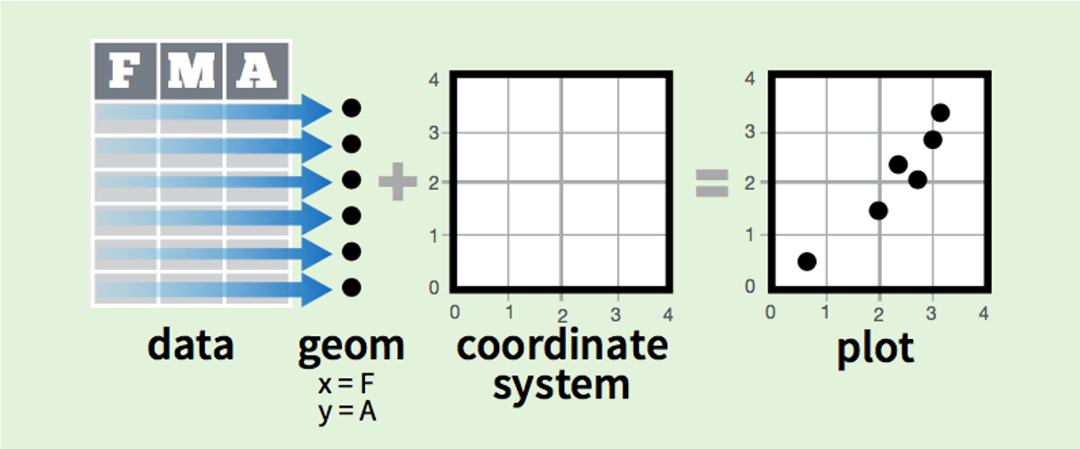
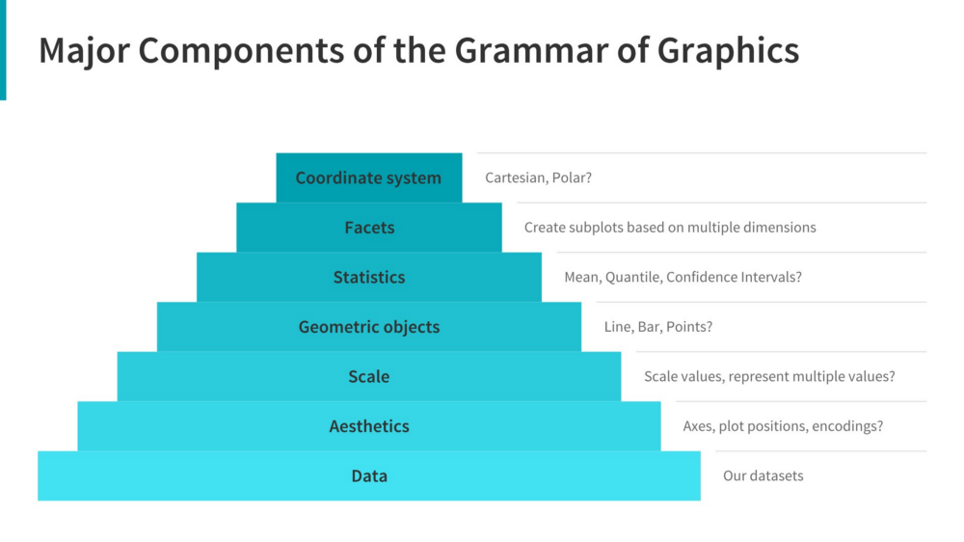
Basic elements in ggplot2 visualisation
https://r-unimelb.gitbook.io/rbook/putting-the-r-in-art/ggplot2-and-the-grammar-of-graphics
data
geom
coordinate system
aesthetics:describe visual characteristics
scales: for each aesthetic, describe how visual characteristic is converted to display values

Slide 11
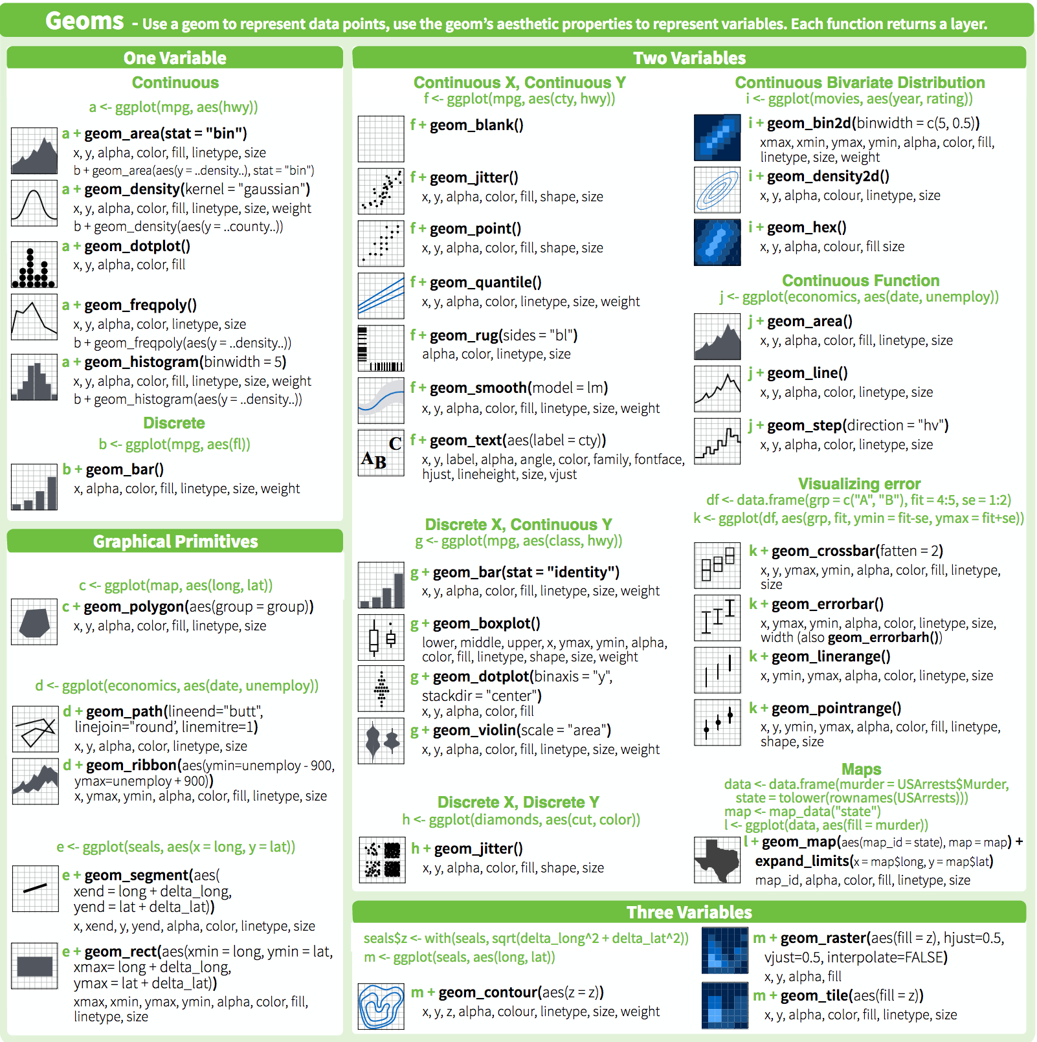
types of geoms
geom_bar()
geom_point()
geom_text()
geom_line()
geom_map()
etc.
http://www.dartistics.com/ggplot2.html

Slide 12
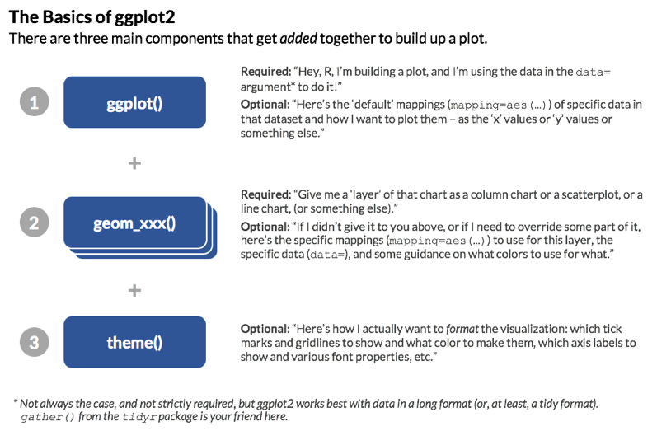
http://www.dartistics.com/ggplot2.html

Slide 13
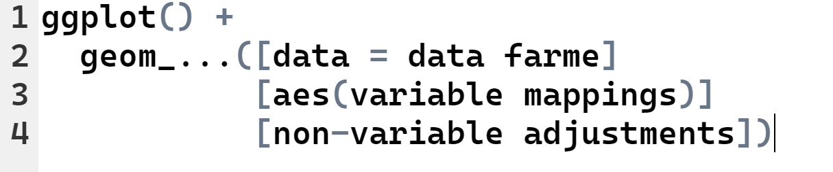
template for a ggplot

Slide 14
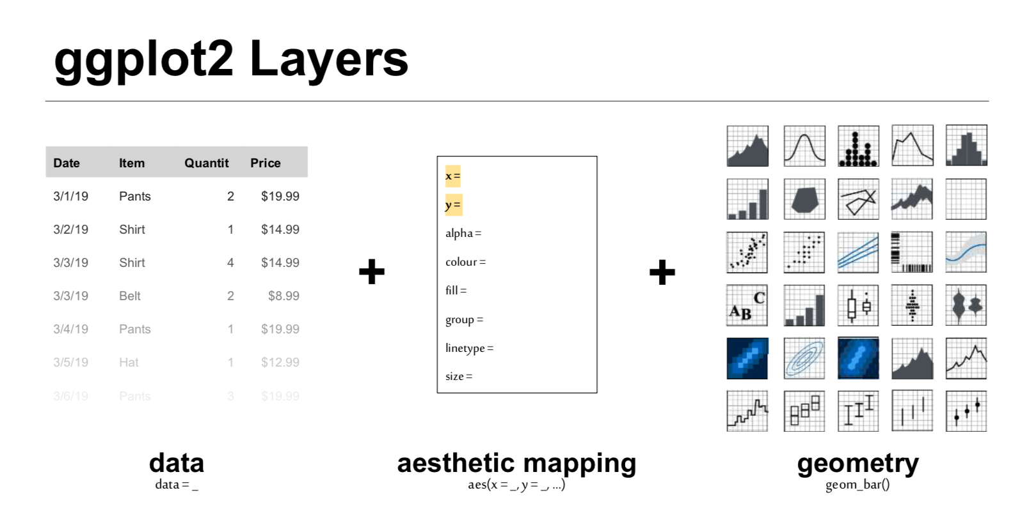

Slide 15
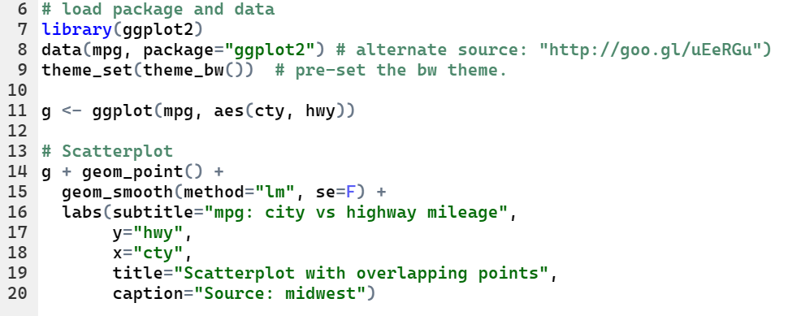
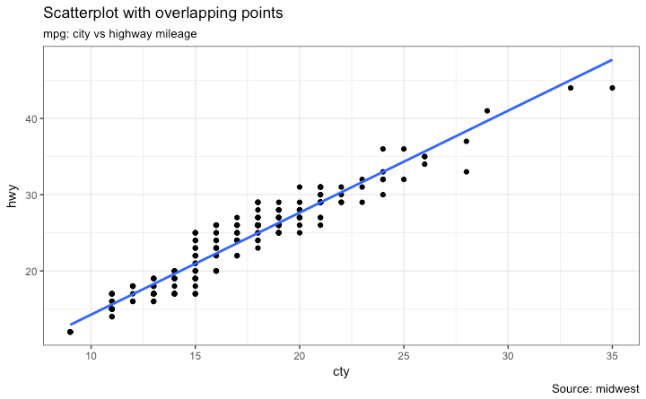
ggplot2 example

Slide 16
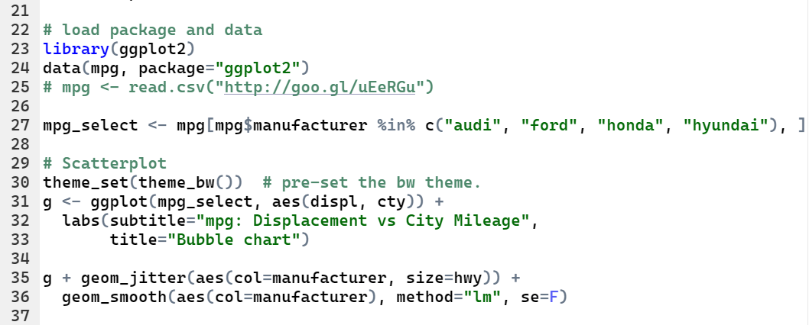
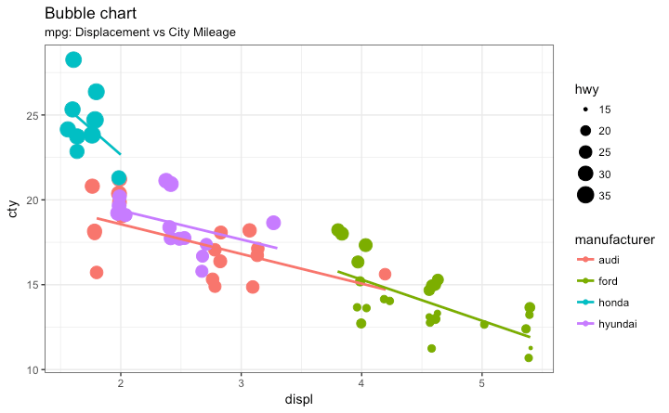
ggplot2 example

Slide 17
How to handle real data ?

Slide 18
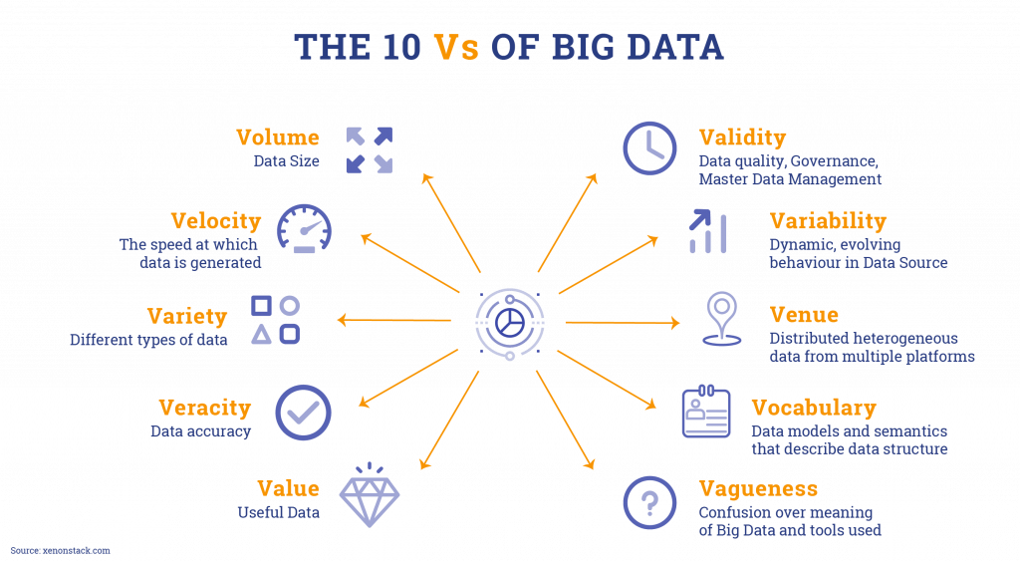
Characteristics of real data
Consistency
Accuracy
Completeness
Auditablity
Validity
Uniqueness
Timeliness
etc.

Slide 19

How to Clean Your Data

Slide 20
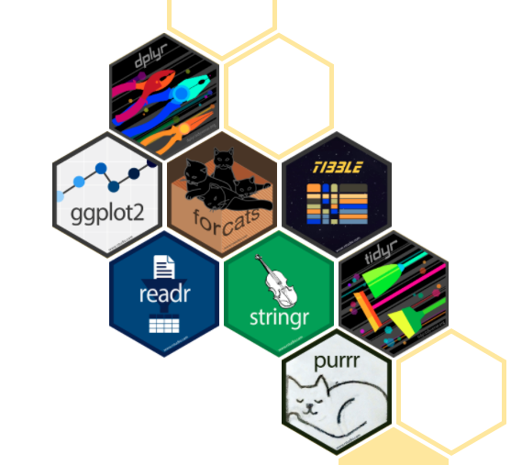
Tidyverse
a collection of R packages
share an underlying design philosophy, grammar, and data structures
written in C++
authored by Hadley Wickham

Slide 21

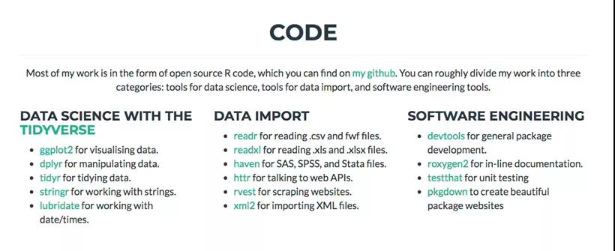
Hadley Wickham

Slide 22

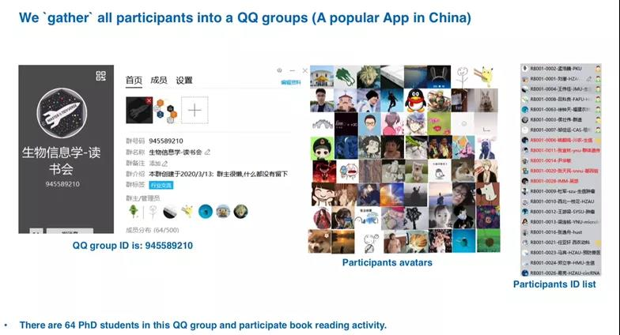
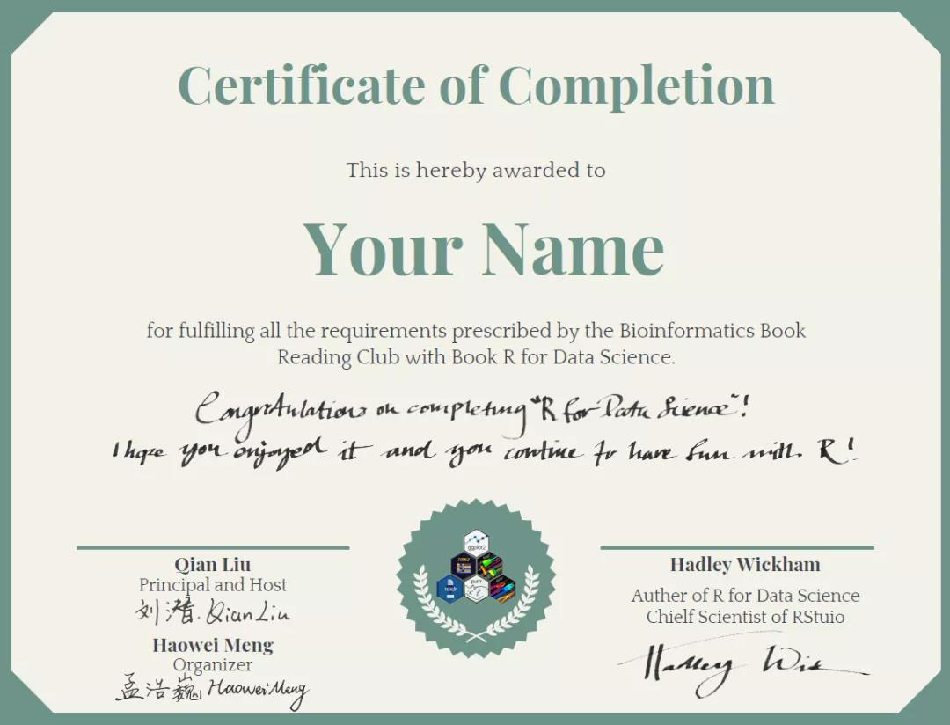
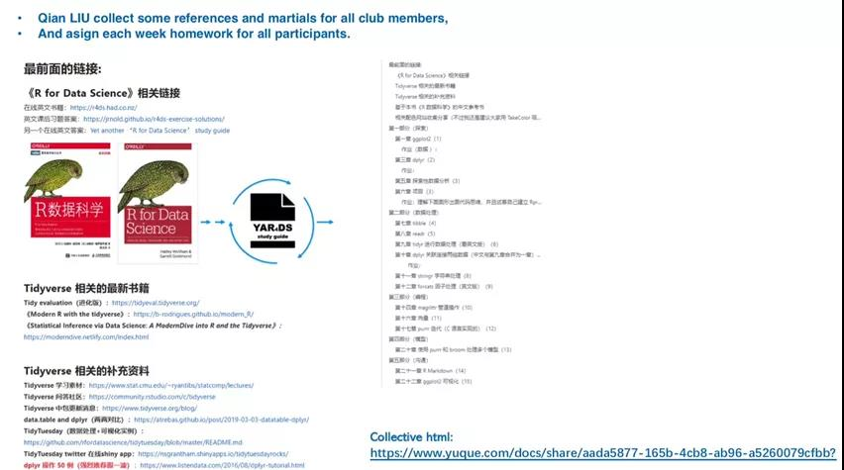
The story about Tidyverse and I

Slide 23
Five key functions
Use filter() to pick observations by their values
Use arrange() to order the rows
Use select() to pick variables by their names
Use mutate() to create new variables with functions of existing variables
Use summarize() to collapse many values down to a single summary

Slide 24
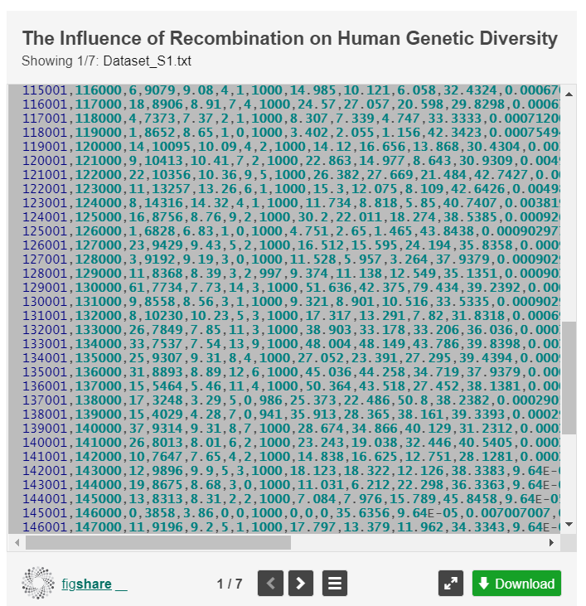
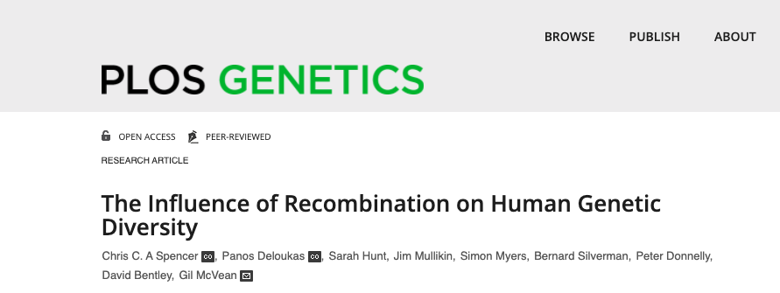
Data
toyData.csv

Slide 25
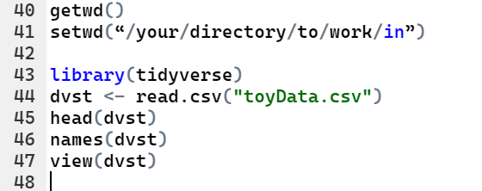
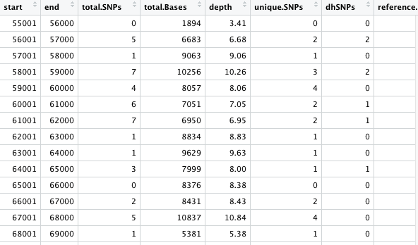
Read and view data on Rstudio

Slide 26
Arguments & filter
The first argument is a data frame (actually, a `tibble`).
The subsequent arguments describe what to do with the data frame, using the variable names (without quotes).
The result is a new data frame.
new data frame
what to do
dvst.highSNPdensity <- filter(dvst, total.SNPs >= 85)
dvst.highSNPdensity <- dvst %>% filter(total.SNPs >= 85)
head(dvst.highSNPdensity)
length(dvst.highSNPdensity$start)
pipes

Slide 27
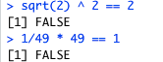
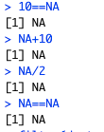
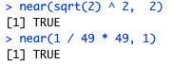
filter(): pitfalls
==, instead of =
Computers use finite precision arithmetic
NAs
dvst %>% filter(is.na(Divergence))
test4 <- dvst %>% filter(!is.na(Divergence))

Slide 28
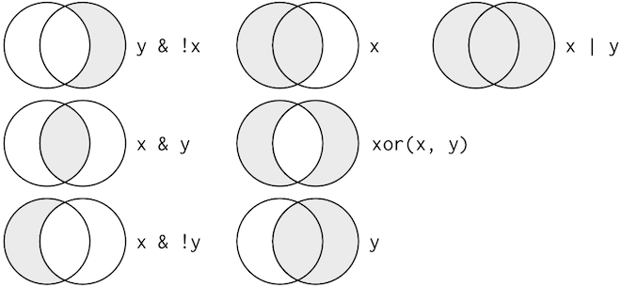
logical operator
& | !
test1 <- dvst %>% filter(Pi > 16 & percent.GC > 80)
test2 <- dvst %>% filter(Pi > 16 | percent.GC > 80)
test3 <- dvst %>% filter(Pi > 16 & !(percent.GC > 80))

Slide 29
Challenge1: filter()
1. Find windows...
with the lowest/highest GC content
that have 0 total SNPs
that are incomplete (<1000 bp)
that have the highest divergence with the chimp
that have less than 5% GC difference from the mean
2. One useful dplyr filtering helper is between().
dvst %>% filter(
between(percent.GC, mean(percent.GC)-5,
mean(percent.GC)+5))
filter(dvst,
between(percent.GC, mean(percent.GC)-5,
mean(percent.GC)+5))

Slide 30
mutate()
add new columns that are functions of existing columns
dvst.test <- dvst %>%
mutate(cent = start >= 25800000 & end <= 29700000)
filter(dvst.test,cent==TRUE)
dvst.test <- dvst %>%
mutate( diversity = Pi / (10*1000))
dvst.test <- dvst %>%
mutate( cent = start >= 25800000 & end <= 29700000, diversity = Pi / (10*1000))
test <- dvst %>%
transmute(diversity = Pi / (10*1000), cent = start >= 25800000 & end <= 29700000)

Slide 31
arrange()
arrange() works similarly to filter() except that instead of selecting rows, it changes their order.
missing values are always sorted at the end!
dvst.test <- arrange(dvst.test, cent, percent.GC)
head(dvst.test)
desc()
dvst.test <- arrange(dvst.test, desc(cent), percent.GC)
head(dvst.test)

Slide 32
select()
test <- select(dvst, start, end, Divergence)
test <- select(dvst, depth:Pi)
test <- select(dvst, -(start:percent.GC))
iris <- tbl_df(iris)
iris
select(iris, starts_with("Petal"))
select(iris, ends_with("Width"))
select(iris, contains("etal"))
select(iris, Species, everything())

Slide 33
summarise()
It collapses a data frame to a single row
summarise() is terribly useful unless we pair it with group_by()
other functions: median(), IQR(), quantile(x, 0.25), n_distinct(),
summarise(dvst, GC = mean(percent.GC, na.rm = TRUE), averageSNPs=mean(total.SNPs, na.rm = TRUE), allSNPs=sum(total.SNPs))
by_cent <- group_by(dvst.test, cent)
summarise(by_cent, GC = mean(percent.GC, na.rm = TRUE))
dvst.test %>% group_by(cent) %>% summarise(GC = mean(percent.GC, na.rm = TRUE))
dvst.test %>% group_by(percent.GC >= 80) %>% summarise(depth=mean(depth), nrows=n())

Slide 34
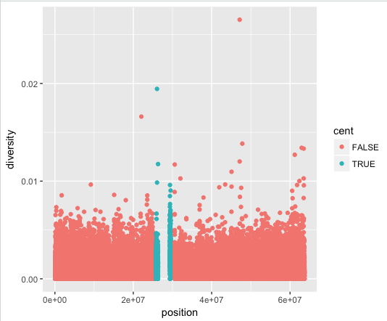
create a scatterplot of nucleotide diversity along the chromosome
dvst <- mutate(dvst, position = (end + start) / 2)
ggplot(data = dvst) + geom_point(mapping=aes(x=position, y=diversity))
ggplot(data = dvst, aes(x=position, y=diversity)) + geom_point()
ggplot(data = dvst) + geom_point(mapping = aes(x = position, y = diversity), color = "blue")
ggplot(data = dvst) + geom_point(mapping = aes(x=position, y=diversity, color=cent), alpha=0.01)

Slide 35
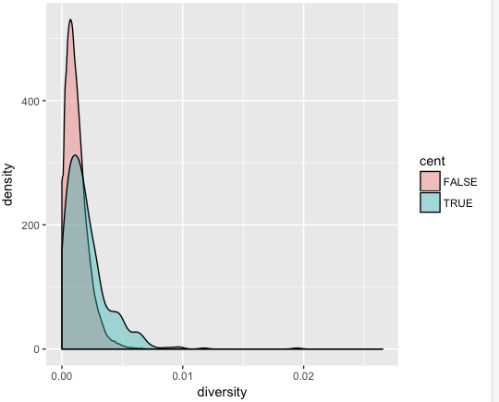
Data visualisation(density plot)
ggplot(data = dvst) + geom_density(mapping = aes(x=diversity), fill="blue")
ggplot(data = dvst) + geom_density(mapping = aes(x=diversity, fill=cent), alpha=0.4)

Slide 36
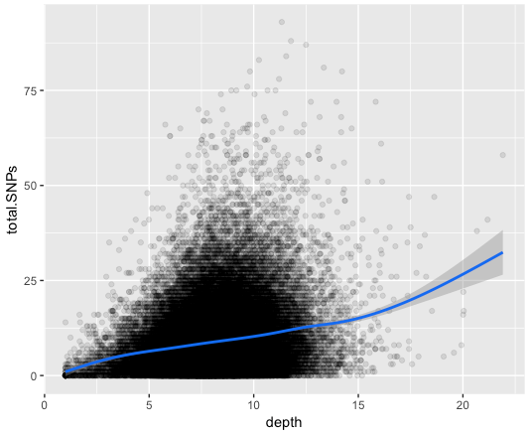
Data visualisation(smoothing)
ggplot(data = dvst, mapping = aes(x=depth, y=total.SNPs)) + geom_point(alpha=0.1) + geom_smooth()

Slide 37
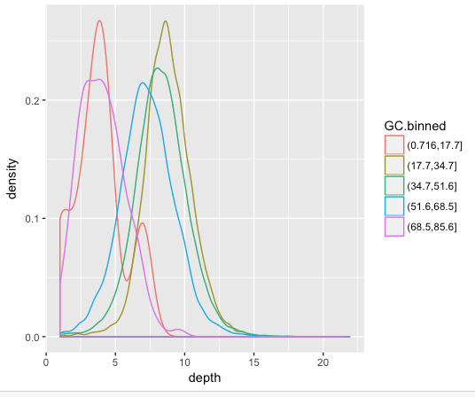
how GC content has an impact on depth
dvst <- dvst %>% mutate(GC.binned = cut(percent.GC, 5))
ggplot(data = dvst) + geom_bar(mapping = aes(x=GC.binned))
ggplot(data = dvst) + geom_density(mapping = aes(x=depth, color=GC.binned), alpha=0.5)
ggplot(data = dvst) + geom_bar(mapping = aes(x=percent.GC))

Slide 38
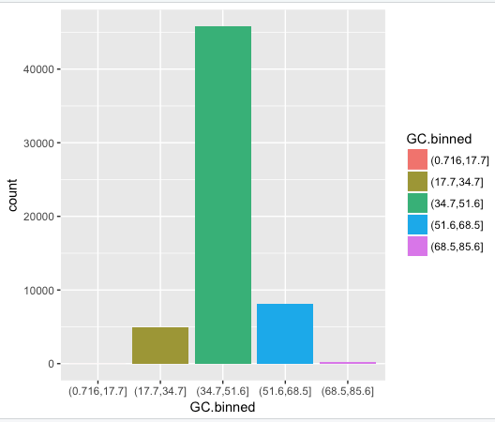
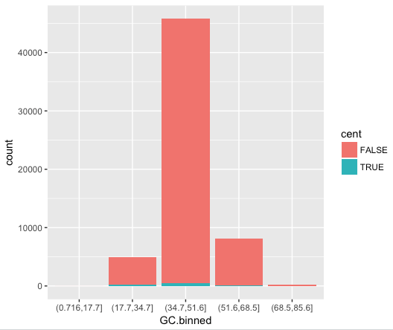
bar plot
ggplot(data = dvst) +
geom_bar(mapping = aes(x = GC.binned, colour = GC.binned))
ggplot(data = dvst) +
geom_bar(mapping = aes(x = GC.binned, fill = GC.binned))
ggplot(data = dvst) + geom_bar(mapping = aes(x = GC.binned, fill = cent))

Slide 39
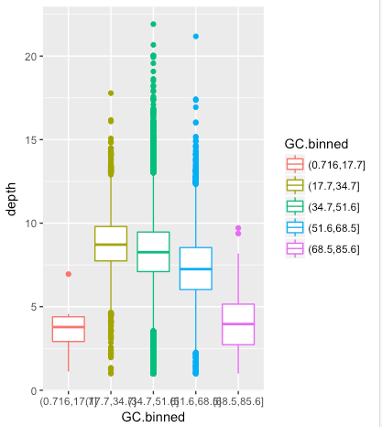
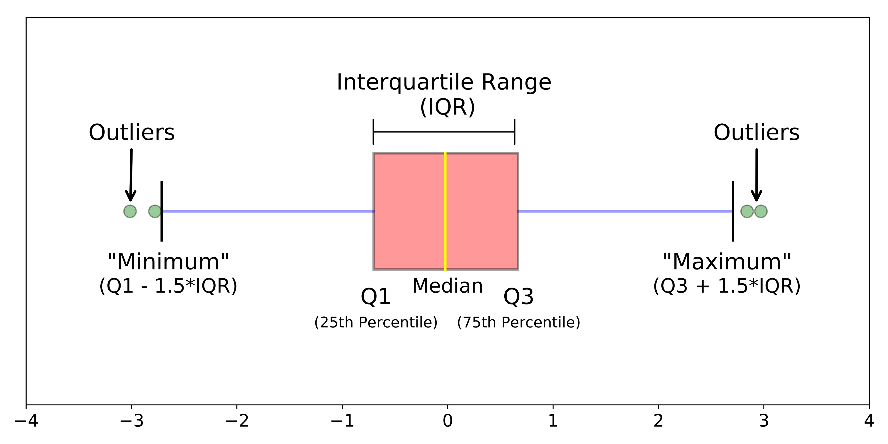
box plot
ggplot(data = dvst) +
geom_boxplot(mapping = aes(x = GC.binned, y=depth, colour = GC.binned))

Slide 40
ggplot2 in Evolution Genomics extending

Slide 41

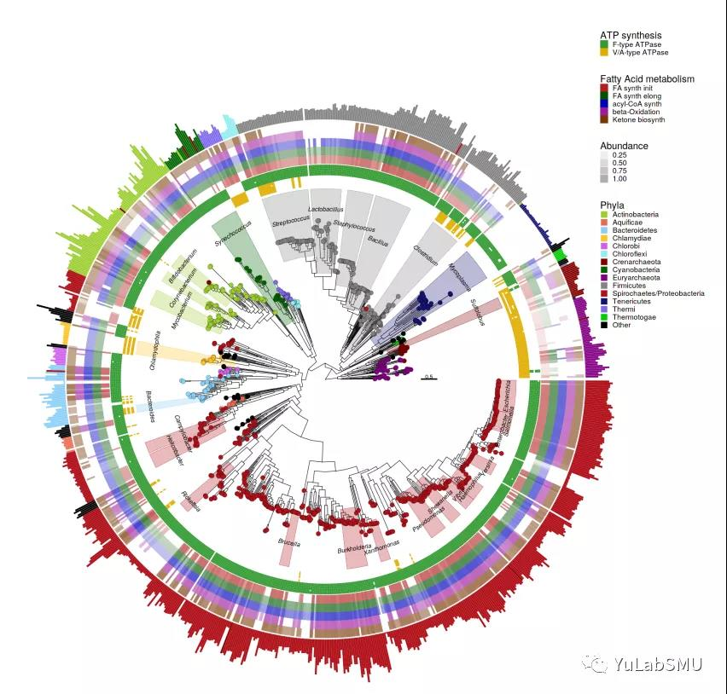
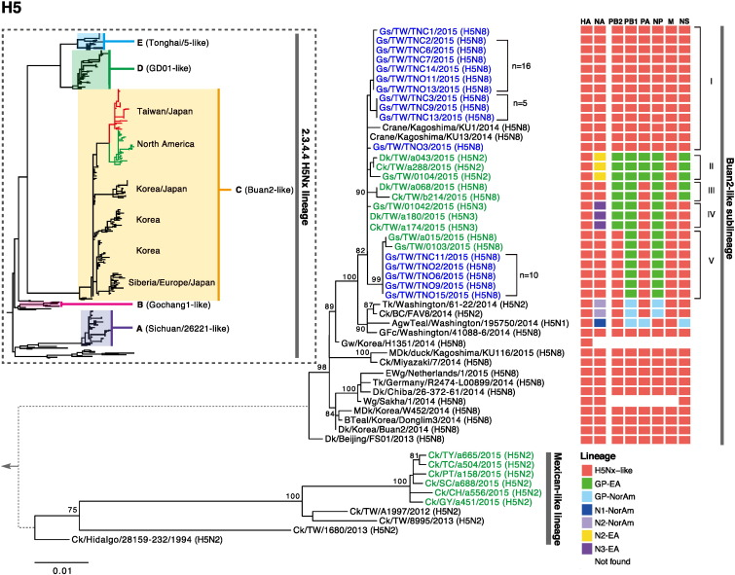
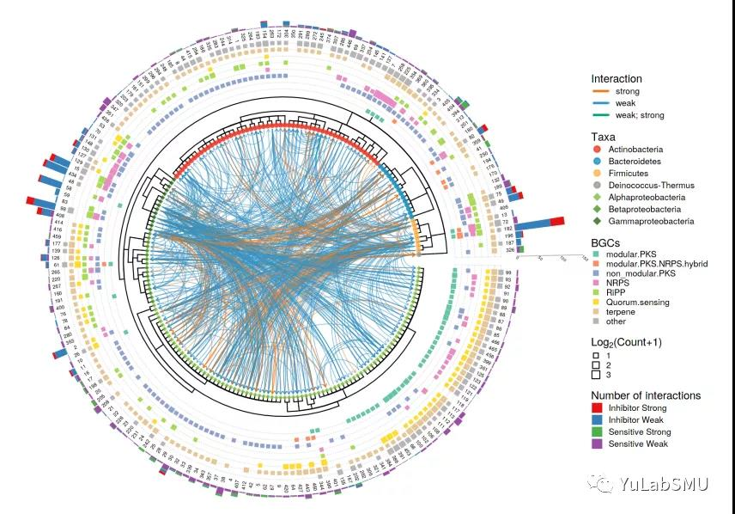
ggtree
powerful to read tree formats
easy to display and annotate tree
powerful to extending other ggplot2’s base package
authored by Guangchuang Yu

Slide 42
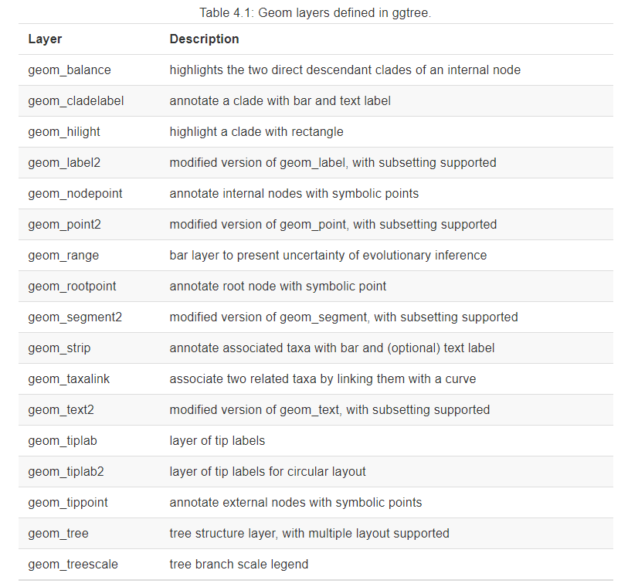
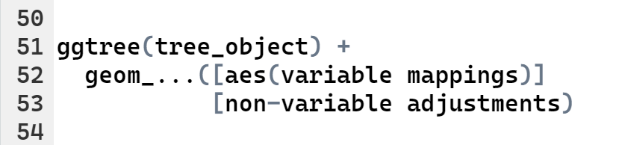
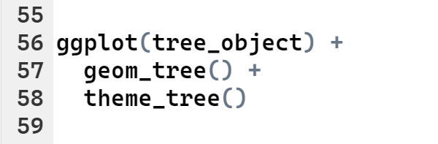
template for a ggtree

Slide 43
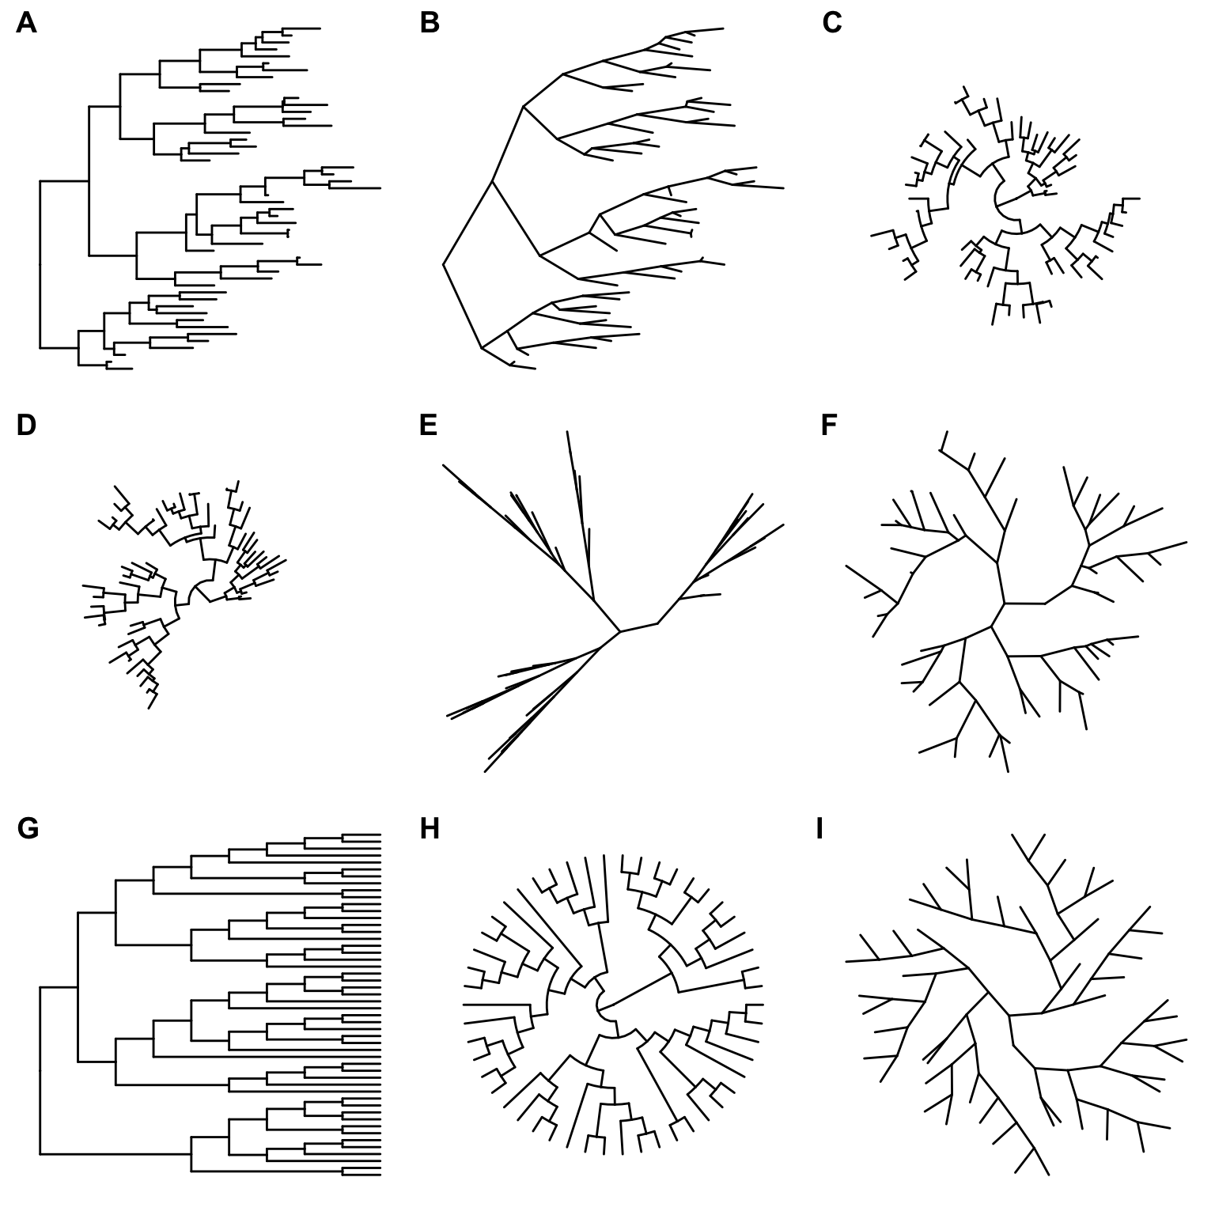
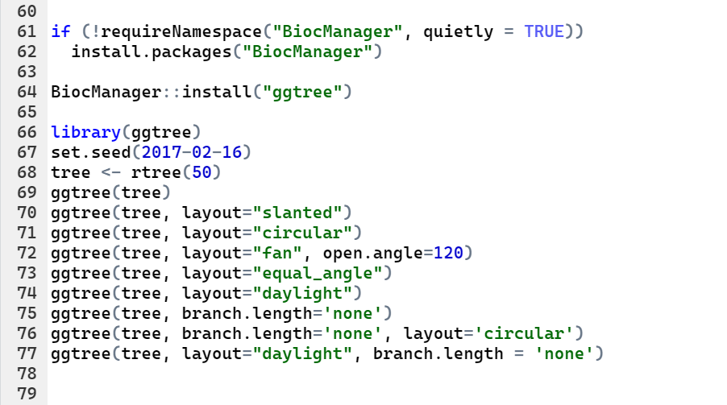
A simple example

Slide 44
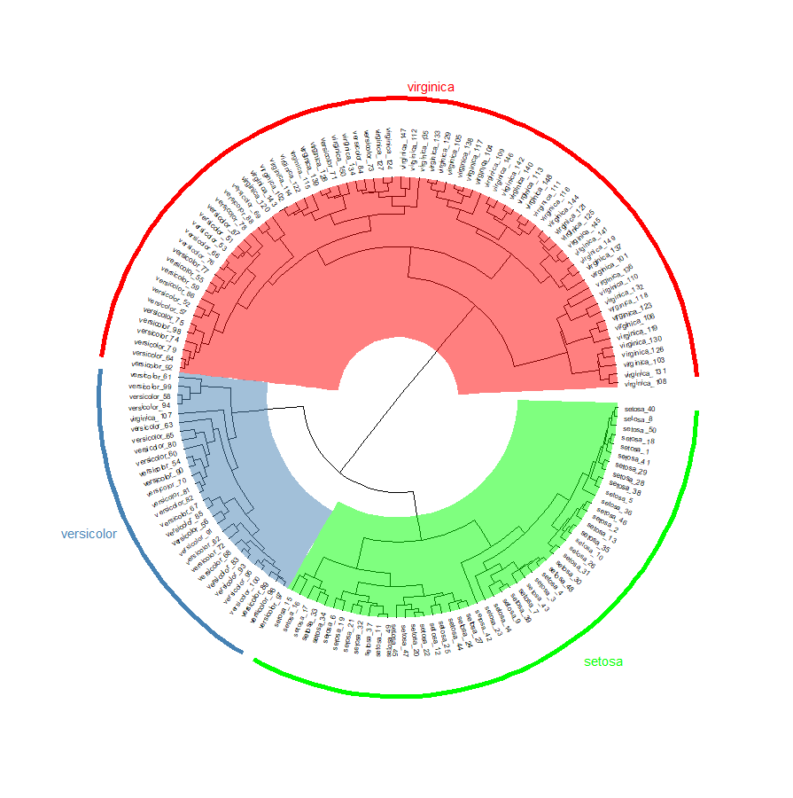
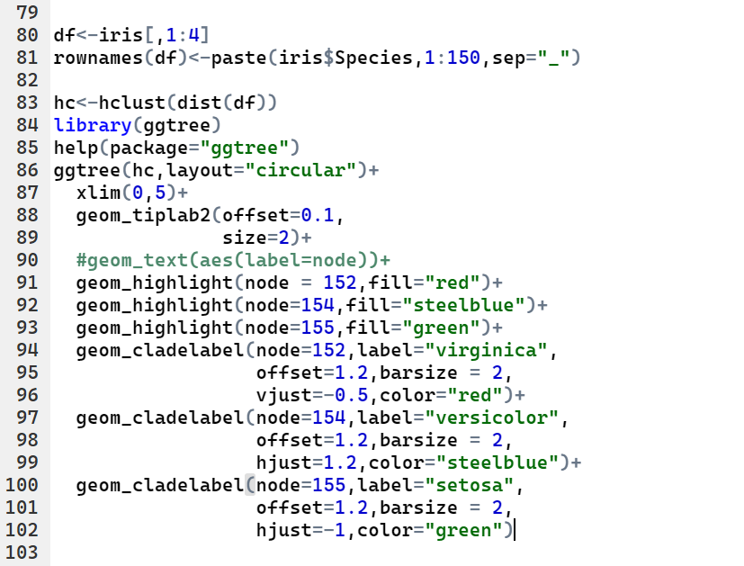
A simple example

Slide 45


Study Material Recommendations
R for Data Science
https://r4ds.had.co.nz/
ggtree codebook
http://yulab-smu.top/treedata-book/
Advanced R
https://adv-r.hadley.nz/

